Slide 1
Student Database
BAN 610
Chanyuan Wen
Munahil Murrieum
Pooja Bhansali
Travis Alderman

Slide 2

Goal of the Project
Collect raw data
Generate business rule to govern the database
Functional Dependencies
2NF to 3NF
Visually design a database (ERD).
Database Diagram
The Tables
Database Queries

Slide 3
1.
BUSINESS RULES

Slide 4
Rules of the Business
Each student must have one and only one unique NetID.
Each student must have one and only one major, each major must have at least one student.(MO-MM)
Each student graduates in one and only one semester of a year.
Each student must take at least one course.
Each course number corresponds to one and only one course.
Each course must have one and only one value for course hours.
Each course can only take place in one and only one classroom, each classroom has one and only one course.(MO-MO)
Each course must have at least one textbook and can have multiple textbooks.
Each textbook must be published by one and only one publisher, a publisher can publish multiple textbooks
Each course is taught by one and only one instructor
Each instructor must have one and only one office.

Slide 5
2.
FUNCTIONAL DEPENDENCIES

Slide 6
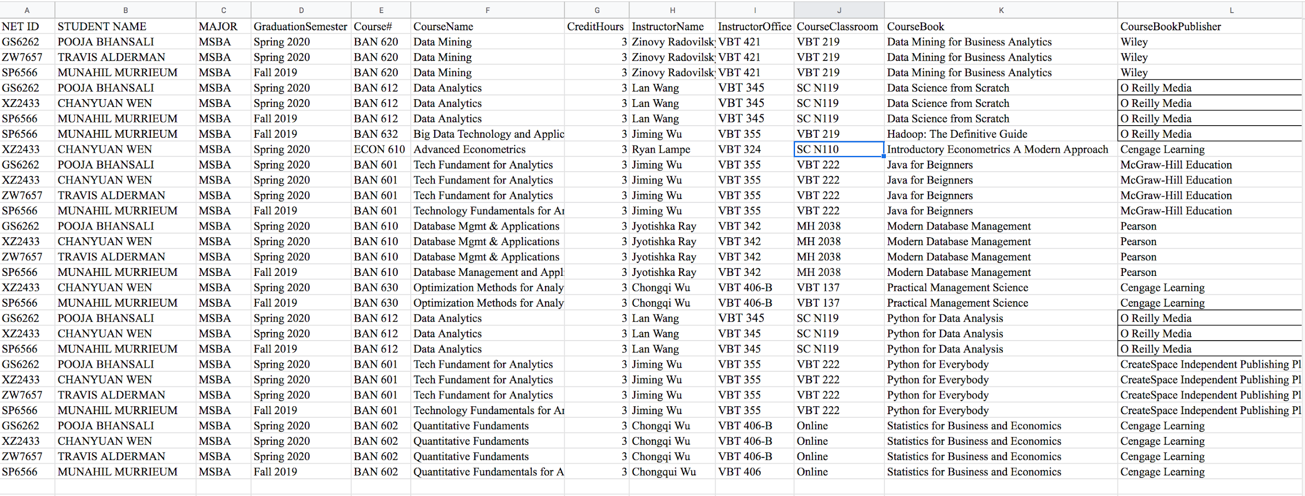
Raw Data Collected

Slide 7
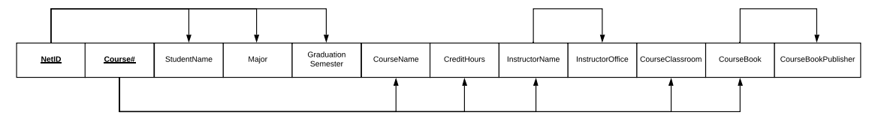
1NF
Partial Dependencies
Transitive Dependencies
Transitive Dependencies
Partial Dependencies

Slide 8
3.
2NF TO 3NF

Slide 9
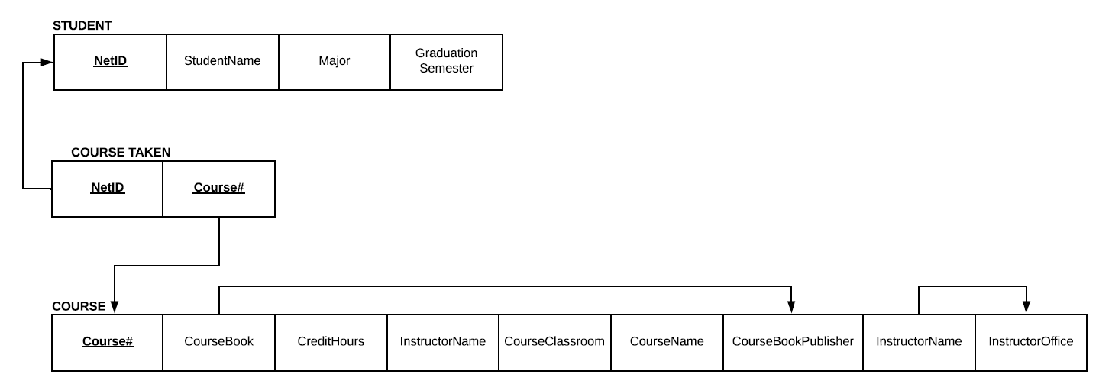
2NF

Slide 10
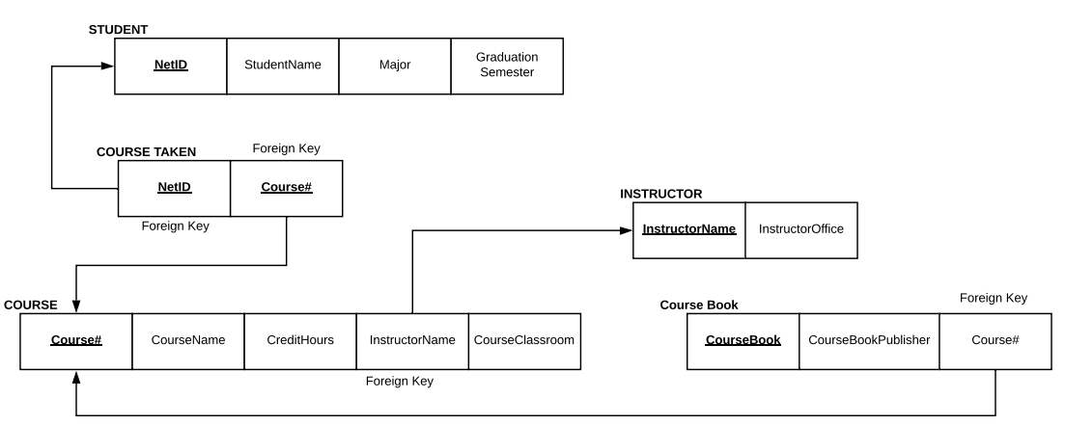
3NF

Slide 11
4.
ENTITY RELATIONSHIP DIAGRAM

Slide 12
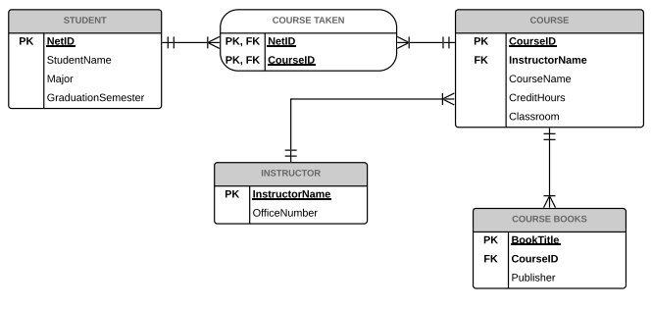
ERD

Slide 13
5.
DATABASE DIAGRAM

Slide 14
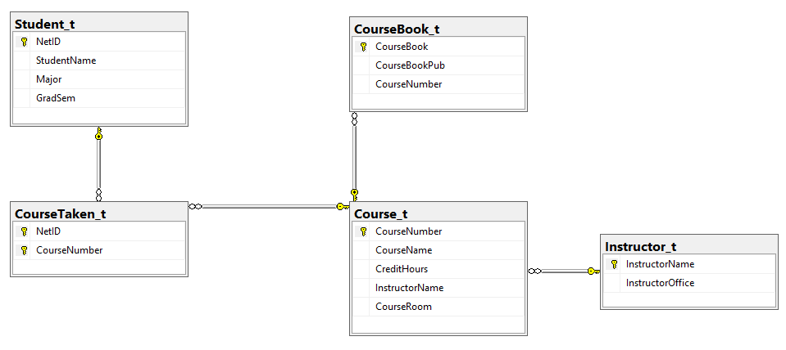
Database Design

Slide 15
6.
THE TABLES

Slide 16
Course Taken Table
COURSETAKEN
Net ID | Course #
GS6262 | BAN 601
GS6262 | BAN 602
GS6262 | BAN 610
GS6262 | BAN 612
GS6262 | BAN 620
COURSETAKEN
Net ID | Course #
XZ2433 | BAN 601
XZ2433 | BAN 602
XZ2433 | BAN 610
XZ2433 | BAN 612
XZ2433 | BAN 630
XZ2433 | ECON 610
COURSETAKEN
Net ID | Course #
ZW7657 | BAN 601
ZW7657 | BAN 602
ZW7657 | BAN 610
ZW7657 | BAN 620
COURSETAKEN
Net ID | Course #
SP6566 | BAN 601
SP6566 | BAN 602
SP6566 | BAN 612
SP6566 | BAN 610
SP6566 | BAN 620
SP6566 | BAN 630
SP6566 | BAN 632

Slide 17
Student and Instructor Tables
STUDENT
NET ID | Student Name | Major | GraduationSemester
GS6262 | Pooja Bhansali | MSBA | Spring 2020
XZ2433 | Chanyuan Wen | MSBA | Spring 2020
ZW7657 | Travis Alderman | MSBA | Spring 2020
SP6566 | Munahil Murrieum | MSBA | Fall 2019
INSTRUCTOR
InstructorName | InstructorOffice
Jiming Wu | VBT 355
Chongqi Wu | VBT 406-B
Jyotishka Ray | VBT 342
Lan Wang | VBT 345
Zinovy Radovilsky | VBT 421
Ryan Lampe | VBT 324

Slide 18
Course Table
COURSE
Course# | CourseName | CreditHours | InstructorName | CourseClassroom
BAN 601 | Tech Fundament for Analytics | 3 | Jiming Wu | VBT 222
BAN 602 | Quantitative Fundaments | 3 | Chongqi Wu | Online
BAN 610 | Database Mgmt & Applications | 3 | Jyotishka Ray | MH 2038
BAN 612 | Data Analytics | 3 | Lan Wang | SC N119
BAN 620 | Data Mining | 3 | Zinovy Radovilsky | VBT 219
BAN 630 | Optimization Methods for Analytics | 3 | Chongqi Wu | VBT 137
ECON 610 | Advanced Econometrics | 3 | Ryan Lampe | SC N110
BAN 632 | Big Data Technology and Applications | 3 | Jiming Wu | VBT 219

Slide 19
Course Books Table
COURSE_BOOKS
CourseBook | CourseBookPublisher | Course#
Python for Everybody | CreateSpace Independent Publishing Platform | BAN 601
Java for Beignners | McGraw-Hill Education | BAN 601
Statistics for Business and Economics | Cengage Learning | BAN 602
Modern Database Management | Pearson | BAN 610
Python for Data Analysis | O Reilly Media | BAN 612
Data Science from Scratch | O Reilly Media | BAN 612
Data Mining for Business Analytics | Wiley | BAN 620
Practical Management Science | Cengage Learning | BAN 630
Introductory Econometrics A Modern Approach | Cengage Learning | ECON 610
Hadoop: The Definitive Guide | O Reilly Media | BAN 632

Slide 20
7.
DATABASE QUERIES

Slide 21
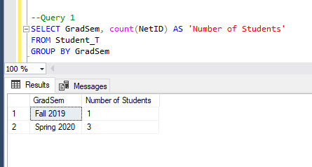
Query 1:Count the number of students who are graduating in the same semester.

Slide 22
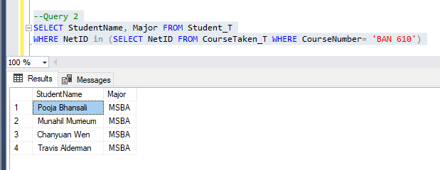
Query 2: Display the students name and major who have taken BAN 610.

Slide 23
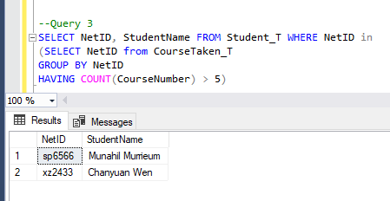
Query 3: Display the NetID and student name of the students who have taken more than 8 courses in year 2018 (adjust the number of courses taken so that the query returns at least one result).

Slide 24
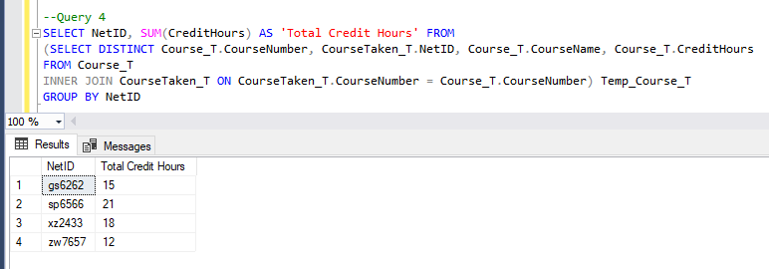
Query 4:Display the NetID and the total credit hours taken by each student in 2018.

Slide 25
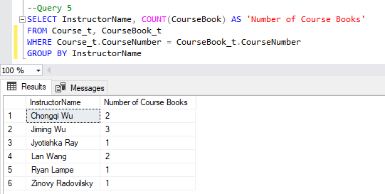
Query 5: Display the instructors name and the number of course books prescribed by each instructor.

Slide 26
THANK YOU

